Slide 1
Design Basics
Interactive Media
Unit 1

Slide 2
Starter – 5 Minutes
Answer the following on your whiteboards:
How would you know how your product should look?
What considerations might you need to make when designing the product?
Can you think of any examples of poorly designed interactive media products?

Slide 3
Learning Outcomes
Understand the decisions made during the design process.
Describe how decisions are made when designing an interactive media product.
Explain how design changes can affect the user and how they interact with a product.

Slide 4
Portfolio Setup
As this is now LO2, you will need to add the following to your portfolio:
A blank page at the end of your LO1 content.
This is so that it is clear where LO1 ends and LO2 begins.
New headings: LO2 (Heading 1) and Design Basics (Heading 1).
Below Design Basics, add another heading Colour (Heading 2).

Slide 5
Knowing your Audience
When creating a product that has user-interaction as a goal, i.e. an interactive media product, you need to consider what it will actually be like for the user to access the product.
Previously, you covered target audiences and the different points you would need to consider when creating a product for your audience.
For example, how might you design a user-interface that is intended for people with limited eyesight?

Slide 6
Captivating your Audience
Depending on the needs of your client, you may need your product to be designed in such a way that it captivates the potential users and promotes them to use the product.
Some studies suggest that people make a judgement about the product they are viewing within 90 seconds of their initial viewing.
What do you think is on the of the key things that people notice?
Up to 90% of that assessment is based on this alone…

Slide 7
Using Colour
Software developers, and those who lean towards the programming side are not frequently known for their user-interface design skills.
This is often left to other members of a team, such as a designer.
When it comes to making your product, your team will be made up of just one person, yourself.
As such, you need to know how to make sensible choices regarding a user interface.

Slide 8
Task 1 – Explaining Colour
Complete the following in your portfolio under the Colour heading:
Add the following bullet points and explain in 2+ sentences how colour can be used for each:
Backgrounds
Buttons
Logos
Themes/Colour Schemes

Slide 9
Colour Palettes
Your client may give you a specific colour, or a general idea of what to use for the product.
One of your jobs will be deciding how you use that information and how you adapt it.
There are several colour palettes, but the most commonly used are:
Monochromatic
Analogous
Complementary
Split-Complementary

Slide 10
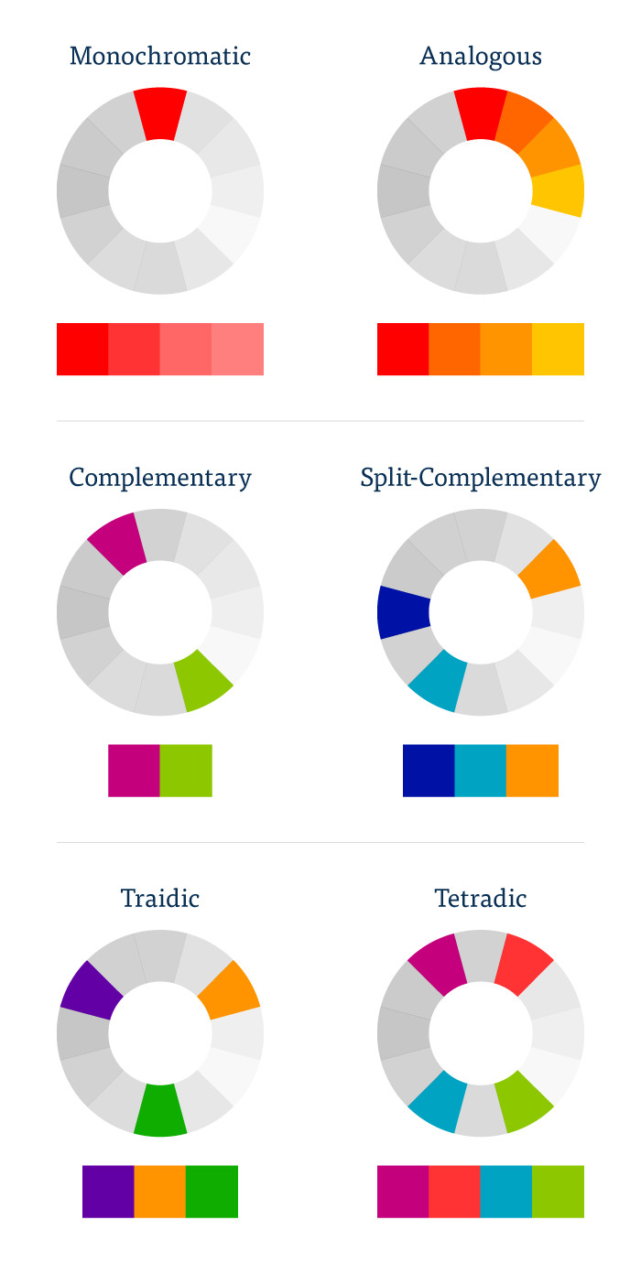
Monochromatic, Analogous
Monochromatic is when hues or tints from a single colour are used only.
Analogous us when multiple neighbouring colours on the colour wheel are used.

Slide 11
Complementary, Split-Complementary
Complementary is created from two opposite colours on the colour wheel.
Split-Complementary is similar, however is uses two near-opposite colours.

Slide 12
Task 2 – Colour Wheel
In your portfolio, under the Colour heading, explain what is meant by each of the following colour options:
Monochromatic
Analogous
Complementary
Split-Complementary
For each one, include a screenshot of an example.
Color wheel, a color palette generator | Adobe Color

Slide 13
Task 3 – Picking Colours
For each of the following scenarios, pick a colour palette and colours using Adobe Colour.
In your portfolio, under the Colour heading, write down the scenario and paste a screenshot of your chosen colours. Include a short explanation as to your choice.
An app for young children for educational purposes.
An interactive informational display at a museum.
An interactive website for people with poor eyesight.
How would the age group effect this example?

Slide 14
Task 4 – Another Heading
Add the following heading to your portfolio, below the Colour heading:
Fonts and Typefaces (Heading 2)
Whitespace (Heading 2)
House Style (Heading 2)

Slide 15
Understanding Typefaces
First of all, what does the term typeface mean?
A typeface is the family of fonts that text belongs to.
There are two main types to consider:
Serif
Sans Serif
What do we think is the difference between these terms?

Slide 16

Serif vs. Sans Serif
The term sans just means without, so the difference between is just that some fonts are with serif and others are without serif.
So what does serif mean?
Serif refers to the additional inflections and strokes on the text, e.g.:

Slide 17
Using Display Fonts
Display fonts are used mainly for decoration on an interactive media product.
They can add some flair to a product, e.g. as a title or tagline.
However, the use should be limited to smaller amounts of text as they are typically harder to read than standard serif/sans serif fonts.

Slide 18
Task 5 – Fonts
In your portfolio, under the Fonts and Typefaces heading:
Explain the difference between serif and sans serif fonts.
For each one, include a screenshot of an example of that font is.
When might serif fonts be used and not sans serif? Why?
Explain what a display font is and where it might be/might not used.
Include a screenshot as an example.

Slide 19
Use of White Space
White Space is another element to plan accordingly for when designing user interfaces.
White space is the area between design elements, e.g. the gap between posts on Instagram or the space between text in a document.
Deciding the correct amount of space between design elements can have an effect on the readability and how it captivates the user.

Slide 20
House Style
A house-style is the general theme used throughout the product.
This can include colour choice, font choice, use of white space etc.
This gives the product an “identity”. Using a consistent house style throughout the product helps promote that “brand”.

Slide 21
Task 6 – House Style
In your portfolio, under the Whitespace heading, explain what white space is.
Include two screenshots; one of good use of whitespace and one of bad use of whitespace.
Explain why each one is either good use or bad use.
Under the House Style heading, explain what a house style is.
Include a screenshot of an example house style from a well-known brand such as Coca Cola or Tesco.
Using your example, explain what the house style elements are, (e.g. red background, serif font, white text)

Slide 22
Task 7 – Your Design
Brief: You are on a team developing a website for a newly built school. There should be elements of the colour orange used as this is part of the logo, but other colours are allowed too.
In your portfolio, under the House Style heading, write out the above brief then write the following as bullet points:
What colours would be used on the website? Why? (Use a screenshot for the colours)
What fonts would be used? Serif or sans serif? What display fonts (if any) will be used?
Explain how much white space will be used and why.
Explain all of your decisions, i.e. why that colour, that font and that amount of white space?
Extension: Produce a wireframe for this website, using your house style.

